Slide 1
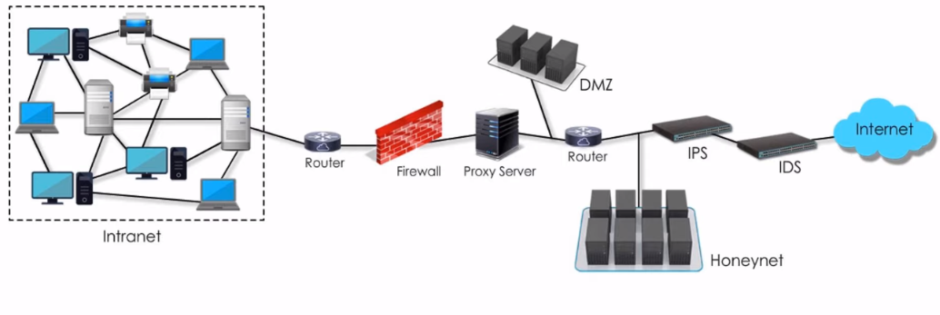
Network Design: Firewall, IDS/IPS
In intranet is a private network which is heavily protected by many different networking devices i.e. Router, Firewall, Proxy Server, DMZ, Honeynet, Ips and IDs.

Slide 2
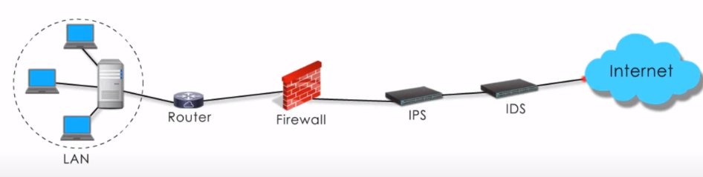
Network Design: Firewall, IDS/IPS
I try to put these devices together in a reasonable order, only for teaching and learning purpose.
So, This presentation will be based on IDS and IPS.

Slide 3
IDS
IDS stands for Intrusion-Detection System
The system is often deployed on the network, close to the perimeter.
It is very much like a CCTV camera above a business entrance or sensors on its doors.
IDs is a passive system that scans incoming traffic.
Once the IDS identifies dangerous or suspicious traffic, it can send alerts but leaves the action to IPS.

Slide 4
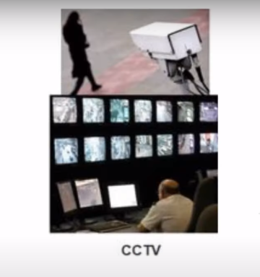
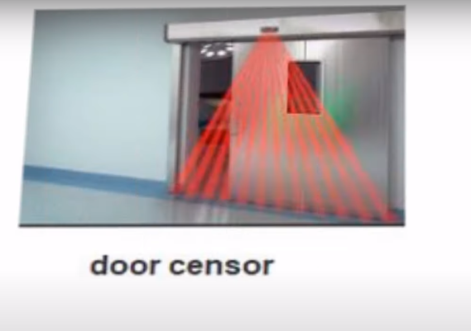

Slide 5
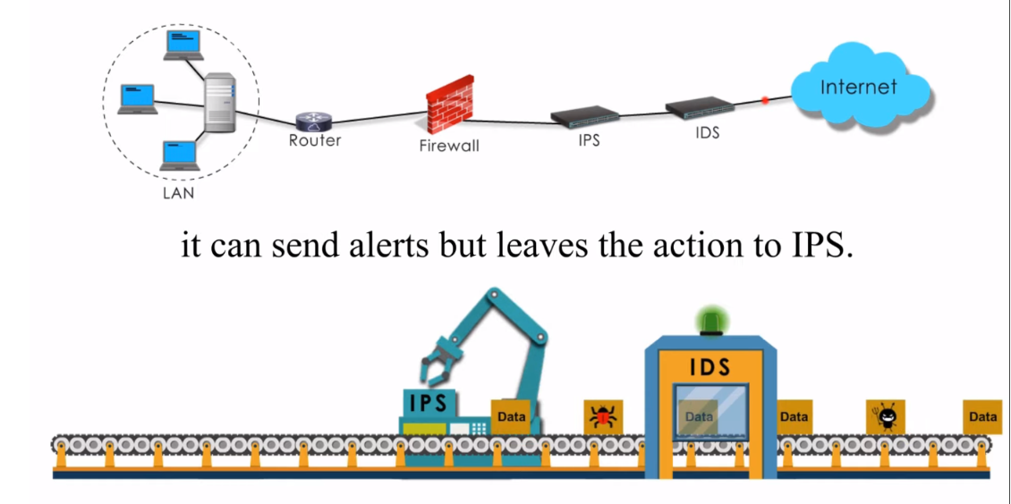

Slide 6
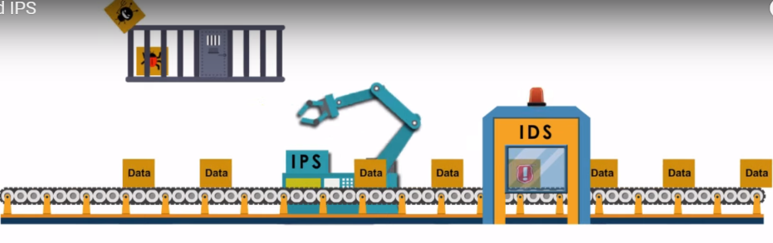
IPS
IPS stands for Intrusion Prevention System
Unlike IDs, IPS is able to actively block or prevent intrusions. It means IPS takes action:

Slide 7
IPS
Inspection and Investigation:
Inspection can include signature based inspection and statistical anomaly-based inspection. Investigation includes analyzing suspicious packets and activities
Action:
Once unwelcome packets are identified, IPS would either put them in quarantine or simply drop them

Slide 8
IPS
3. Logs and Reports:
Like many security devices, IPS can log attacks and send reports.
Keep in mind, IDS and IPS are not necessarily two seprate physical devices. They can be combined into one device.

Slide 9
IPS
They can be also combined with other devices, such as firewall, router, or proxy, into a single device.
Unified Threat Management(UTM)
And Next-Generation firewalls are two examples.

